Slide 1
Gameweek 1
Purpose, summary, results, squad, next actions

Slide 2
Purpose
To amass as many points in FPL using Data Driven Methods as far as possible
We can have side goals: e.g. How can we predict price change? But that must be a means to our end as above

Slide 3
Summary of actions taken
Predict points change with Linear Regression (ML)
To evaluate if we can use form in the same season to predict the final price of a player
Predict change in price with Linear Regression (ML)
To evaluate if we can predict which players are going to increase in value at the start of the season
Identify undervalued players with Linear Regression (Excel)
Same reason as above
Use Template + TSB players
Utilizing knowledge from previous best FPL players

Slide 4
Results
Predict points
Was OK, but realistically not helpful as the player data for would not have been known before the season
Predict change in value
Unable to predict the last five largest changes in value at all. Standard deviation of players was sort of reasonable at 0.3m
Identify Undervalued players
Trend towards players that have played very little, as I only have data about each players’ minutes played and not starts. The larger the number of minutes played, the lower the point to minute ratio
Use template players
Use the wisdom of previous managers. Get the most commonly held assets where possible, because you do not want to be left behind and having to play catch up later when the commonly held asset (Halaand) scores a lot. Conversely, if commonly held assets are not scoring, there will not be a huge gap between you and people in front of you.

Slide 5
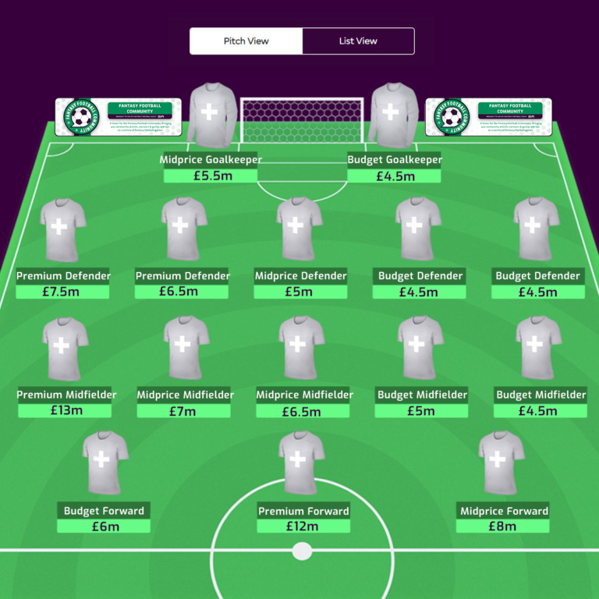
Template
Spread the budget chosen
Rationale: helps to secure a player in each of the price ranges. Easier to switch out to another player within the price range if necessary
Implication: Need to keep a keen eye on up and rising players, buy them before the price increases

Slide 6
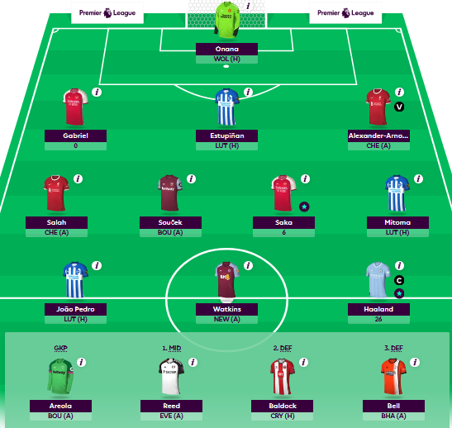
Squad
Onana and Areola most owned GKs
All defenders are most owned defenders for their slots
All midfielders are most owned for their slots other than Soucek and Reed, chosen for their high Minutes Played and points earned

Slide 7
Next Actions
Focus on collating data efficiently
Most time was spent on this – difficult to actually work on this when school starts as I won’t have much time. Need to be able to quickly get the clean data that I want, then carry out the experiments that I want to
How to predict the points haul for the next five matches?
Based on form? Favourable fixtures?
Good websites to follow
www.fantasyfootballscout.co.uk

